Slide 1
Analyzing Security Output

Slide 2
Host-based IDS/IPS
Intrusion Detection System/Intrusion Prevention System
Originally a separate tool
Now integrated into many networking “endpoint” products
Protect based on signatures
Works off decrypted data “This appears to be…”
Protect based on activity
“Why are you modifying that file?”

Slide 3
Antivirus
The viruses are out there
It’s just a mater of time
From computers running Kasperky Lab products in Q2 2019:
717,057,912 malicious attacks blocked
217,843,293 malicious URLs identified
232,292 blocked ransomware attacks
753,550 malicious installing packages on mobile devices
Antivirus applications alert and log malicious software
Will catch on download or execute
Will catch when visiting a known-bad URL
Source

Slide 4
File integrity check
File hashing helps identify any changes
See File Hashing lab
Operating system check
Are the original files still in place?
Windows command: sfc /scannow

Slide 5
Host-based firewalls
Protects against activity on the network
Restrict access to your personal computer
Protects wherever you go
Laptops and mobile devices travel and are more susceptible
Restricts by application and network ports
The firewall watches and knows what you’re doing
Vigilant for you
Logs and displays connection attempts
Allows and denied access
Will catch unwanted activity

Slide 6
Application whitelisting
Decisions made by the operating system
Often built-in to the operating system management tools
Application hash
Only allows applications with this unique identifier
See File Hashing
Certificate
Allows digitally-signed applications from certain trusted publishers
Path
“Only run applications in these folders”
Network zone
“Only run applications from this network zone”

Slide 7
Removable media control
USB drives, portable hard drives
Malware infections
Drives brought to/from home
USB drives all over the parking lot
Exfiltration
HUGE amounts of data, fits in your pocket
Windows Event Log
Security auditing
View USB media use, log filenames copied to removable drives

Slide 8
Advanced malware tools
Specialized removal and recovery tools
Malware techniques vary widely, special tools to combat them
Malware is pervasive
Spreads to all parts of your operating system
Sometimes best recovery is to delete and restore from good backup
May not always be an option
Research as much as possible
Gather recon from the malware tools
Read malware reports, watch trends
Easier: Stop it and prevent it

Slide 9
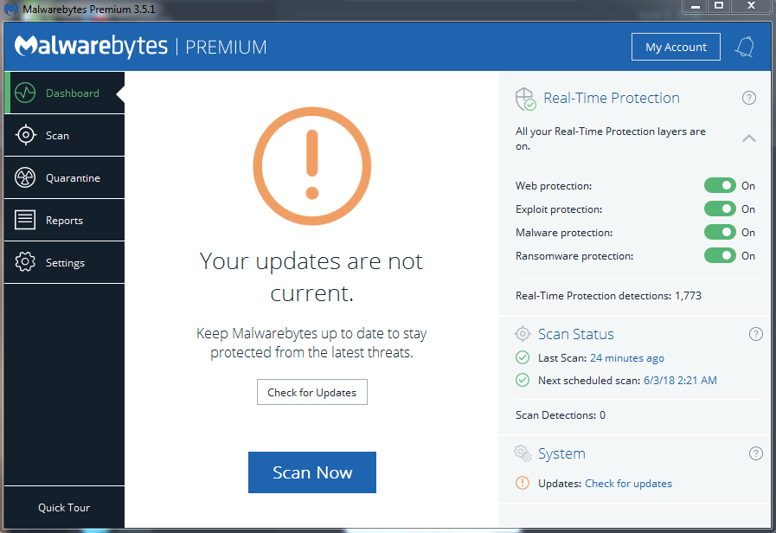
Malware Scanner
Malware Bytes

Slide 10
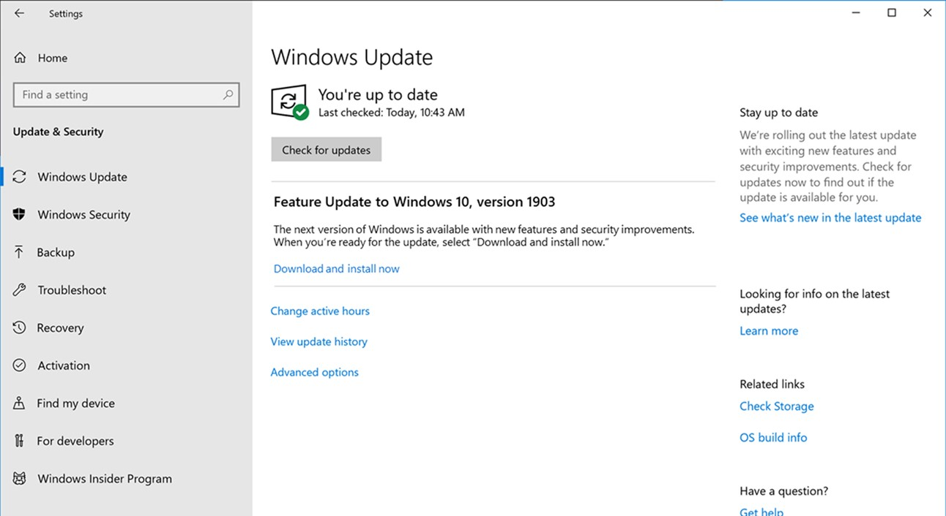
Patch management tools
Windows Update

Slide 11
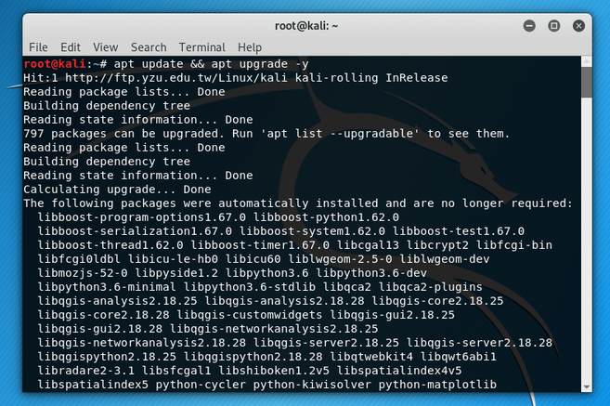
Patch management tools
Linux: apt-get upgrade

Slide 12
UTM/All-in-one security appliance
Unified Threat Management (UTM)
Web security gateway
URL filter / Content inspection
Malware inspection
Spam filter
CSU/DSU
Router, switch
Firewall
IDS/IPS
Bandwidth shaper
VPN endpoint

Slide 13
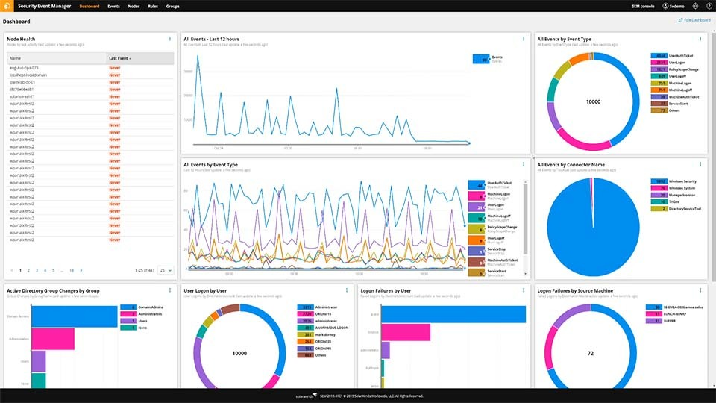
UTM Logs
Solarwinds

Slide 14
Data Loss Prevention (DLP)
Where does your data reside?
Social Security numbers, credit card numbers, medical records
Prevent unwanted access to sensitive data
Data “leakage”
Many sources, Many destinations
Requires multiple solutions in different places

Slide 15
Data Execution Prevention (DEP)
No-eXecute bit
Intel calls it the XD bit (eXecute Disable)
AMD calls it Enhanced Virus Protection
Designates sections of memory as executing code or data
Code cannot execute from a protected memory location
Prevents malware and viruses from executing
OS must support this feature
Windows calls it Data Execution Prevention (DEP)
Enabled by default
Logs shown in the Event Viewer

Slide 16
Web application firewall (WAF)
Not like a “normal” firewall
Specific firewall application
Applies rules to HTTP/HTTPS conversations
“Allow” or “Deny” based on expected input
Unexpected input (injection) is common method of exploiting web applications
SQL injection
Add your own commands to an applications SQL query
WAF catches these “edge cases”
A major focus of the Payment Card Industry Data Security Standard (PCI DSS)

Slide 17
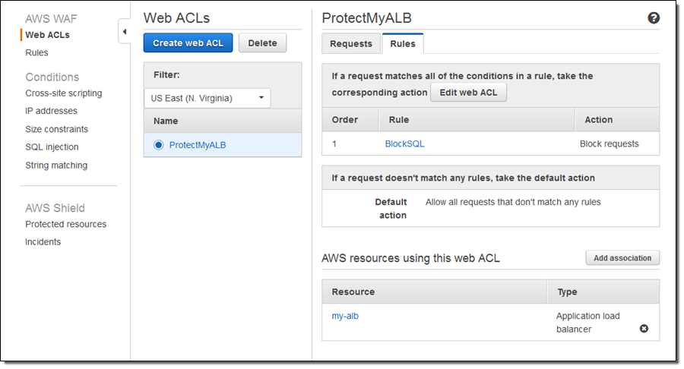
WAF log
AWS Web Application Firewall

